Slide 1
Healthcare Referral Data & Hop Teaming
Mikil Taylor
Director of Analytics @ Healthcare Bluebook

Slide 2

AGENDA
Introduction & Background
Hop Teaming Dataset
NPIs and NPPES
Other Potentially Useful Datasets

Slide 3
My Background
Nashville Native
Recovering Actuary
At Healthcare Bluebook since 2012
Outside of work
Notes:
Outside work – farm, my house is more famous than I am (has its own Wikipedia page), writing a book, reading

Slide 4

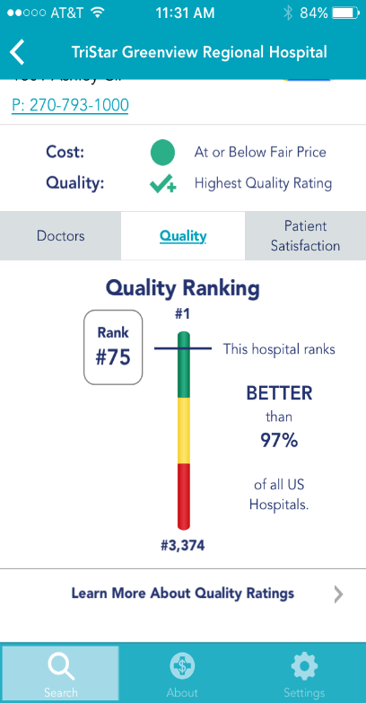
Healthcare Bluebook
Protect Patients by Exposing the Truth and Empowering Choice
Healthcare Price and Quality transparency
Download the free app!
Notes:
We help patients understand the cost and quality of their healthcare. Where you go for care makes a big difference in terms of the cost you pay, and the quality you receive. For example, an MRI may cost you $500 at one location, and $2,000 at a different location across the street. Since most of us have high deductible plans, we end up paying that difference out of our owns pockets. We think that’s unfair, so we try to balance the scales back in favor of the patient.
Also, we’re hiring for at least 4 different positions in Data & Analytics right now, and we love hiring NSS students
One of the things we do to help people understand their healthcare is point them to where their doctor is likely to refer them for imaging or surgeries. For this, we use our hop teaming data

Slide 5
Hop Teaming

Slide 6

Social Graph
Facebook, Twitter, LinkedIn, etc
Nodes and edges
Notes:
Social graphs

Slide 7
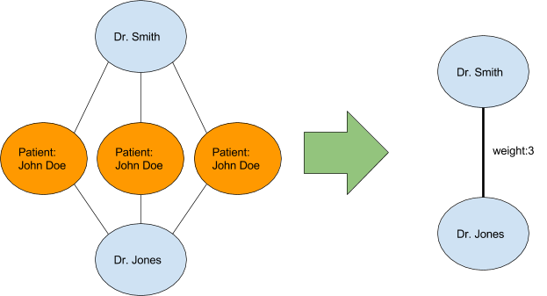
Hop Teaming
Social Graph for Healthcare
Nodes are Doctors and Facilities
Edges are shared patients
Notes:
Largest publicly available social graph
One difference is that our graph is actually directional

Slide 8
Directional Patient Flows
Edges are directional patient flows
These can be different depending on direction
More Twitter, less Facebook
Dr Smith
Jan 1
First Doctor | Second Doctor | Count
Dr Smith | Dr Jones | 1
Dr Jones | Dr Smith | 0
John Doe
Jan 5
Dr Jones
Notes:
Let’s go through some examples, and what the data will look like
Pause here – who has questions

Slide 9
Directional Patient Flows (cont.)
Additional visit
Jan 15
Dr Smith
First Doctor | Second Doctor | Count
Dr Smith | Dr Jones | 1
Dr Jones | Dr Smith | 1
John Doe
Jan 1
Jan 5
Dr Jones

Slide 10
Directional Patient Flows (cont.)
Add doctors
Dr Crane
First Doctor | Second Doctor | Count
Dr Smith | Dr Jones | 1
Dr Smith | Dr Crane | 1
Dr Jones | Dr Smith | 0
Dr Jones | Dr Crane | 1
Dr Crane | Dr Jones | 0
Dr Crane | Dr Smith | 0
Jan 15
Dr Smith
John Doe
Jan 1
Jan 5
Dr Jones
Notes:
One office visit (Crane) actually resulted in two implied referrals, from both Smith and Jones
Any questions on what causes this data?
Let’s talk about the data we actually have

Slide 11
Hop Teaming Data
IDs
from_npi
to_npi
Description
patient_count
transaction_count
average_day_wait
std_day_wait
Notes:
IDs and Descriptions

Slide 12
Tips
Lower patient counts generally reflect “accidental” referrals
Highest patient counts frequently represent interactions with bulk providers
Labs, Hospitals, etc
Comparing specialties of both NPIs is a wonderful way to cut through noise
Orthopedists to Hospitals
All MDs to Radiology Centers
Where MDs order their labs
Some specialties are unlikely to refer out
Lab facilities may have little to no influence on where patient goes next
Notes:
Can’t just sort by count and assume that the highest numbers are your best data
How can you get to best data? Context!
Referrals from labs are probably accidents

Slide 13
Tips (cont.)
High average day wait generally reflects “accidental” referrals
Low average day wait often reflects extremely tightly integrated orgs
ER Physician and Hospital
Read the documentation

Slide 14
Caveats and Limitations
Derived from Medicare data
Consider who and what Medicare covers (and doesn’t cover)
CMS (Center for Medicare & Medicaid Services) Privacy Policy
Any relationship with fewer than 11 different patients is suppressed
Inferred referrals, not explicit
Notes:
Medicare doesn’t pay for many births, or pediatrician visits
Most importantly, this is inferred by data, NOT ACTUAL EXPLICIT REFERRALS. You have to use the data to figure out which ones were probably explicit
All we have in the hop teaming data is ID, so let’s connect that to some names and addresses

Slide 15
NPI & NPPES

Slide 16
What is an NPI
National Provider Identifier
10 digit unique number assigned to both individuals and organizations
Mandatory for all bills to Medicare
Freely available data set from CMS (Center for Medicare Services)
Best “key” value to use for most providers

Slide 17
Main NPI fields
Entity Type
1 = Provider (doctors, nurses, etc)
2 = Facility (Hospitals, Urgent Care, Doctor Offices)
Name
First/Last etc
Organization/Other Organization Name
Address
Business Practice Location (not mailing)
Taxonomy Code
Up to 15
Use Primary Switch = Y – not always in spot 1
Notes:
Really wide file, we only need some of those fields

Slide 18
Caveats and Limitations
Little to no QA or Validation
Zero incentive for provider to keep accurate or up to date
Old addresses, retired doctors, incorrect specialties, home phones, etc
Little to no standardization
Provider Credential Text contains “MD” and “M.D.”
Physicans are required to have only one NPI
Some have an additional NPI for their office
Facilities can have multiple NPI
Hospitals frequently do this
Facilities can use one NPI for multiple locations
Notes:
You may see St. Thomas refer to St. Thomas

Slide 19
Other Useful Datasets

Slide 20
Taxonomy Codes
ID for different specialties
Crosswalk to specialty name
We will primarily work with “Allopathic & Osteopathic Physicians”
Most specialties are listed after first slash (after Allopathic & Osteopathic Physicians), but before second slash (specialization)
8 taxonomy codes we would call “Otolaryngology”
Internal Medicine is the exception, specialty is what’s after the second slash (if available)
Gastroenterology, Neurology, etc

Slide 21
CCN
CMS Certification Number
Intended to be unique Hospital identifier
Some exceptions
Freely available from CMS
No publicly-available crosswalk from NPI to CCN

Slide 22
Data.cms.gov
Go exploring!

Slide 23
Goals option 1
Join the Hop Teaming, NPI, and Taxonomy datasets together
Filter from_npi
Entity Type 1
Specialist (Orthopedic Surgeon, Cardiology, etc)
Filter transaction_count > 50
average_day_wait < 50
Filter to_npi
Entity Type 2
Hospital
Within a local CBSA, show which hospitals specialists typically refer patients to
https://www.huduser.gov/portal/datasets/usps_crosswalk.html
Notes:
Huge dataset, we need to cut it down
Transaction count and average day wait are approximations, you’re welcome to play with those numbers

Slide 24
Goals option 2
Join the Hop Teaming, NPI, and Taxonomy datasets together
Filter from_npi
Entity Type 1
Specialist (Orthopedic Surgeon, Cardiology, etc)
Filter transaction_count > 50
average_day_wait < 50
Filter to_npi
Entity Type 2
Analyze how facility type referrals differ by specialty
Do orthopedists refer to different types of facilities than cardiologists?

Slide 25
?
QUESTIONS

Slide 26
Appendix

Slide 27
Documentation
Hop Teaming (in order of relevance)
https://careset.com/datasets/hop-teaming/
https://careset.com/docgraph-hop-teaming/
https://careset.com/rootnpigraph/
NPPES
https://www.cms.gov/Regulations-and-Guidance/Administrative-Simplification/NationalProvIdentStand/Downloads/Data_Dissemination_File-Readme.pdf
Taxonomy Code
https://www.cms.gov/Medicare/Provider-Enrollment-and-Certification/MedicareProviderSupEnroll/Taxonomy

Slide 28
Data
DocGraph Hop Teaming
https://careset.com/datasets/
NPPES
http://download.cms.gov/nppes/NPI_Files.html
CCN
https://data.medicare.gov/Hospital-Compare/Hospital-General-Information/xubh-q36u
Taxonomy
https://data.cms.gov/Medicare-Enrollment/CROSSWALK-MEDICARE-PROVIDER-SUPPLIER-to-HEALTHCARE/j75i-rw8y
Other
Data.CMS.gov

